Slide 1

The Impact of Self-consumption Regulation on Individual and Community Solar PV Adoption in Switzerland: an Agent-Based Model
Master Thesis Final Presentation
Prakhar Mehta, MEST
Supervisors: Danielle Griego, Alejandro Nuñez-Jimenez
Examiner: Professor Dr. Arno Schlüter

Slide 2
Agenda
Introduction and Motivation
Data and Methodology
Results
Conclusion and Discussion

Slide 3

Notes:
Tremors around the world – govt act

Slide 4



The Energy Transition
2017
2035
11.4 TWh
PV
1.6 GW → 7 GW
20 TWh
1.4 TWh

Slide 5
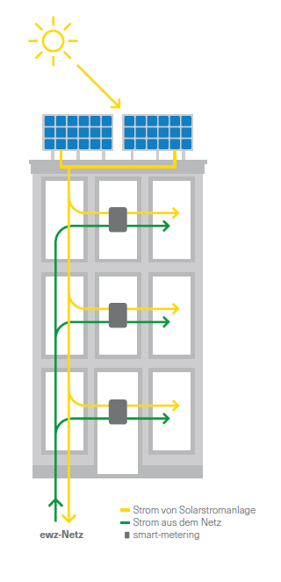
Helpful New Regulations – Energy Act 2018
Zusammenschluss für Eigenverbrauch (ZEV) Formation
Self-consumption Communities
Restrictions:
Can’t share across public property, roads, other private properties
Buildings must be adjacent, common grid connection
Investment Subsidy until 2030: up to 30% investment costs
for 2 kW – 50 MW PV Systems
FiT: 7.91 Rp./kWh
EWZ Factsheet Solarsplit
Notes:
Typical 3-4 person household = 3500 – 4500 kWh per year = 3-4 kW PV enough
Mandatory for EWZ: FiT = 7.91Rp./kWh in Zurich
Only one-time subsidy from government: up to 30% of PV system costs
Multiple → Single customer
Building Owner/Tenants → form ZEV, share system costs and electricity in premises
Idea is to not put extra electricituy into the grid

Slide 6
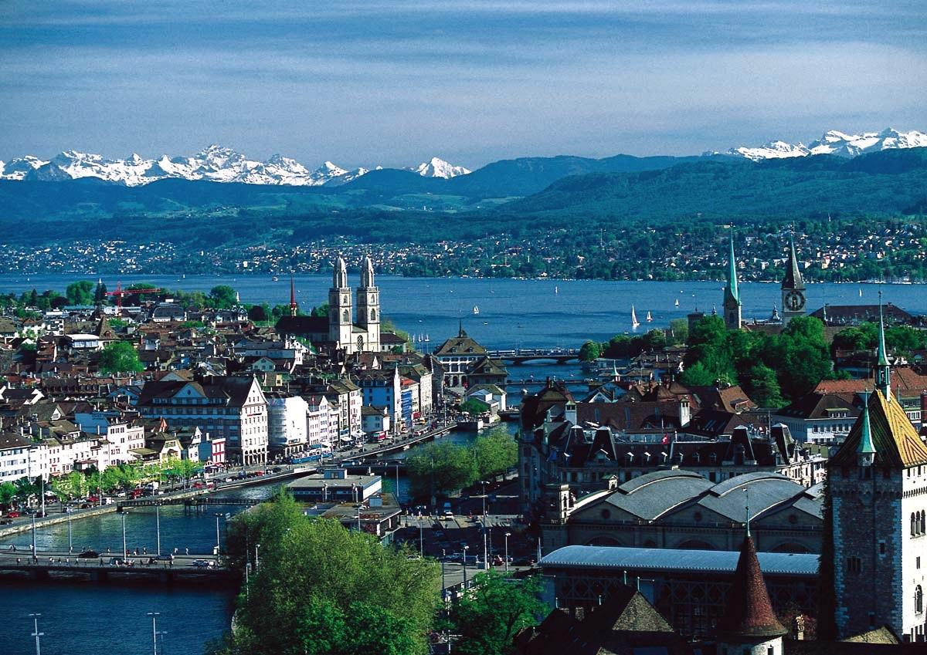
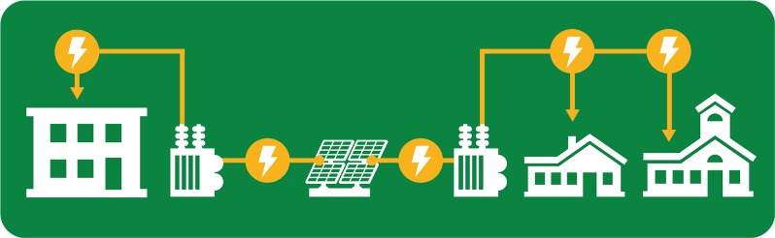
ZEV = Community Solar!
Community PV Systems
Economies of Scale
Complementary Load Profiles
Financial Benefits/Products
Notes:
Not just one bldg. – multiple come together
Community solar definition -
Great case for community solar
Complementary building types closely packed together
Alt-Wiedikon: high resolution CEA data

Slide 7
Problem Statement
How will the dynamics of future solar PV adoption evolve in urban Switzerland, given the new regulations which incentivize individual solar PV adoption even more than before, and allow the formation of self-consumption communities?
Will community PV adoption outpace individual PV adoption?
What potential policy implications and problems can be foreseen?
Notes:
Need for solar and new regulations in place

Slide 8
Objectives
Use of regulations to form potential communities in Zurich
Develop a decision-making methodology for solar PV adoption – individual and community
Explore the dynamics of individual and community solar PV adoption under the new regulations for the period 2018-2035 in the district of Alt-Wiedikon, Zurich.
Scenarios
Notes:
Research Questions
Will the adoption of community scale solar PV outpace individually owned solar in the Swiss urban context, given current regulations?
What elements of the current regulation have greater impact on adoption levels?
Level of subsidies
Size of allowed communities

Slide 9
Agenda
Introduction and Motivation
Data and Methodology
Results
Conclusion and Discussion

Slide 10
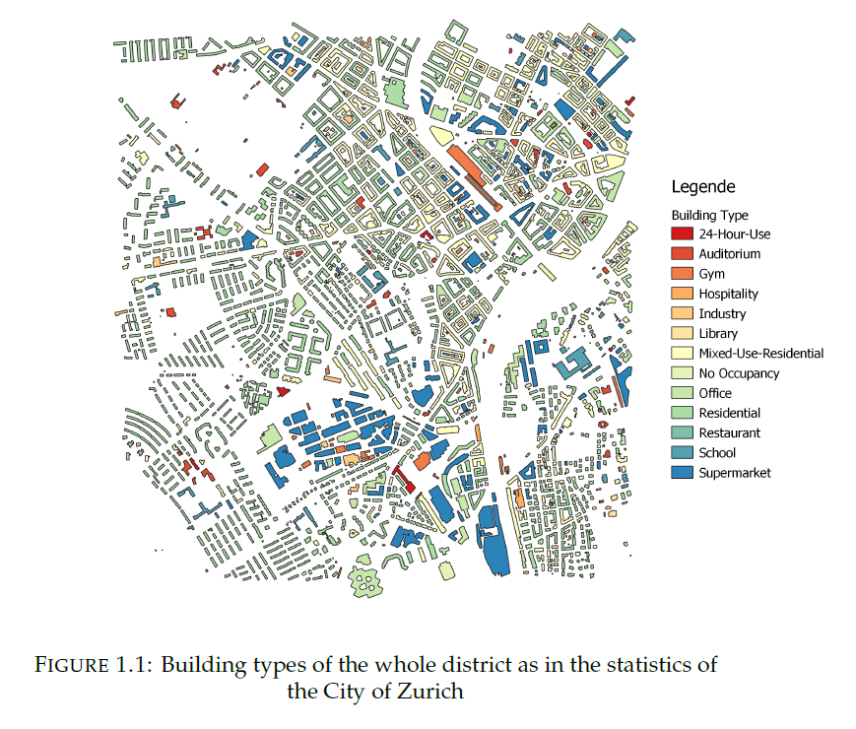
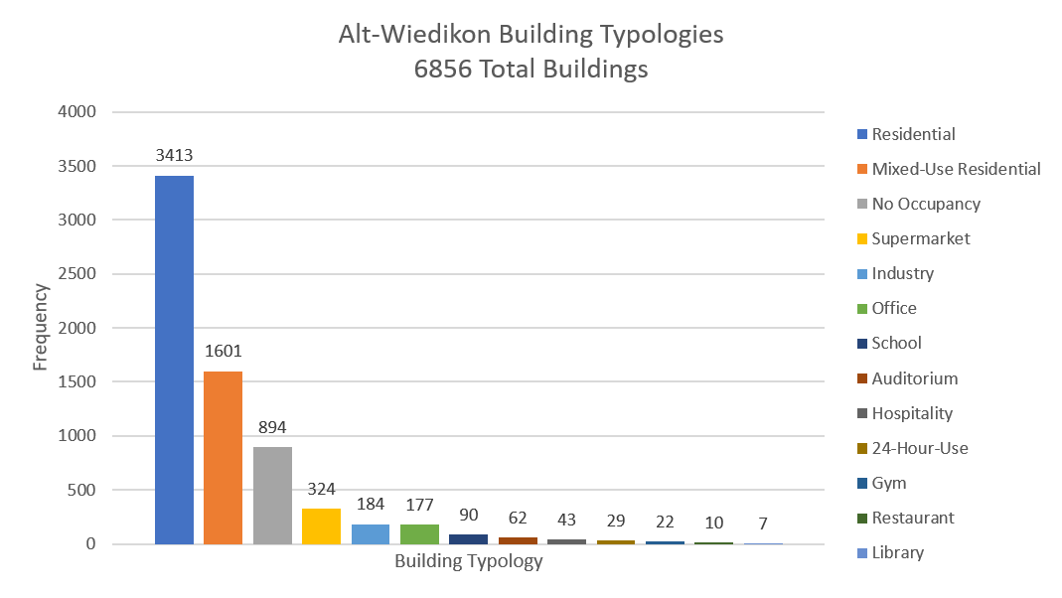
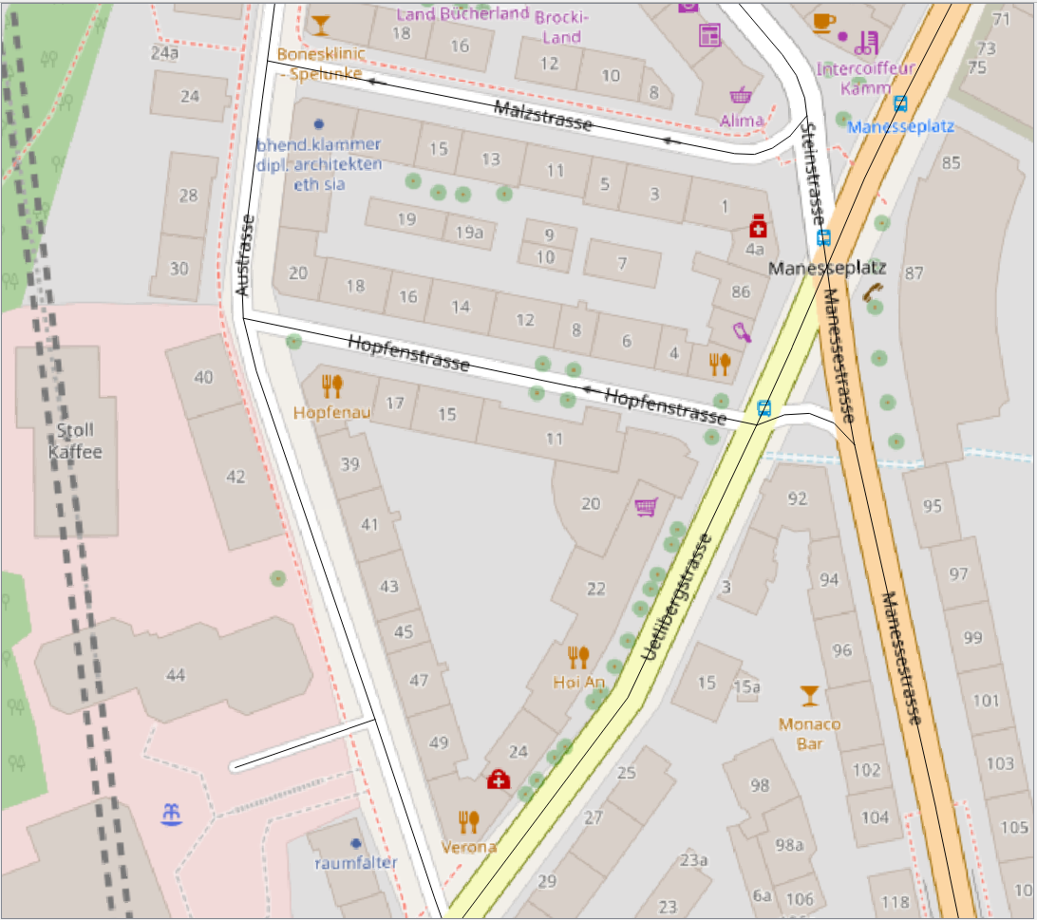
Alt-Wiedikon Buildings Distribution
6856 Buildings 13 Typologies
73% Residential/Mixed-use Residential
Notes:
Diff bldg. types and age

Slide 11
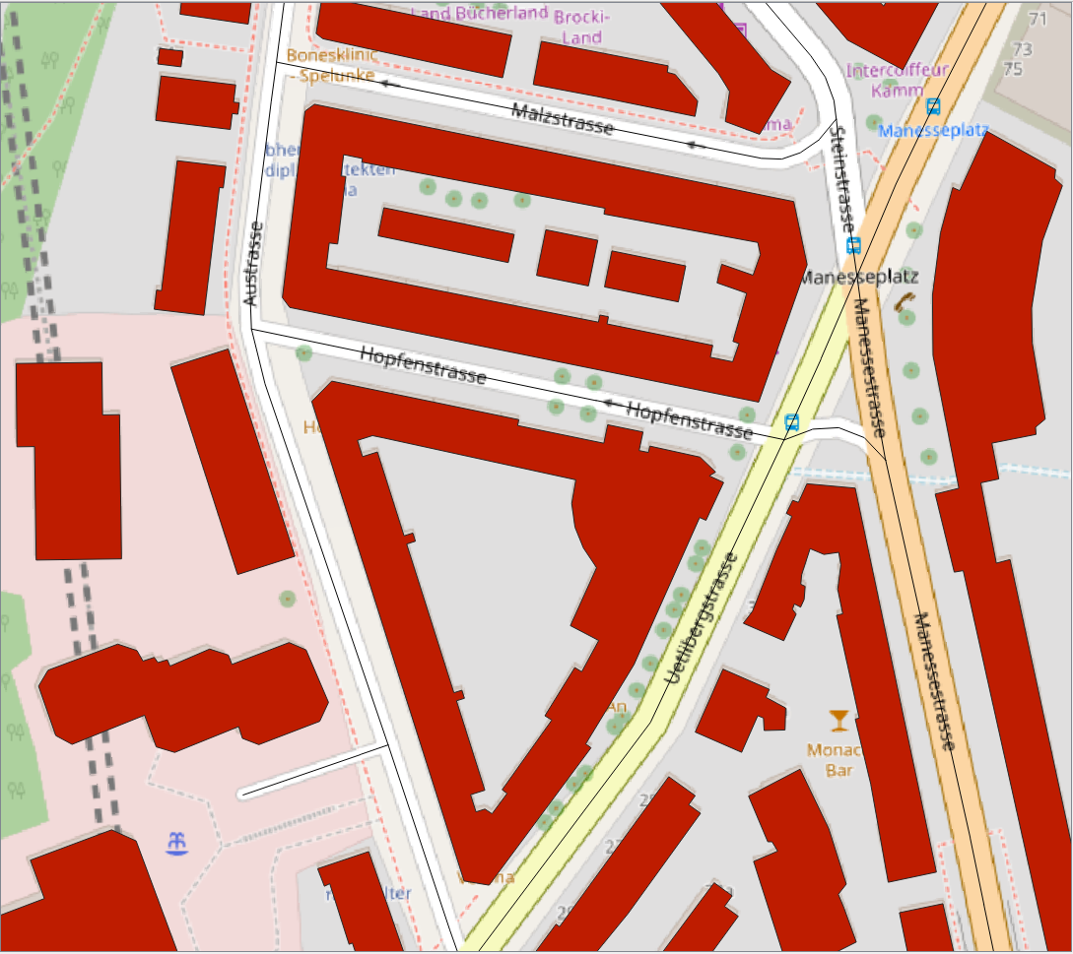
Aggregation of Buildings
1 building block
14 buildings

Slide 12
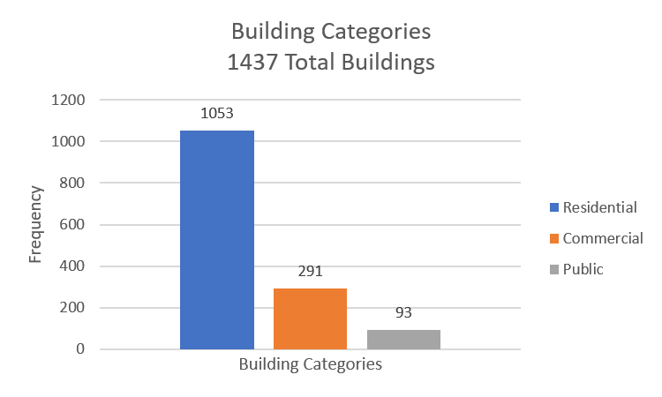
Alt-Wiedikon Buildings to Building Blocks
6856 Buildings → 1950 Building Blocks
13 Typologies
73.27%
3 Typologies
20.25%
6.47%
Notes:
Diff bldg. types and age

Slide 13
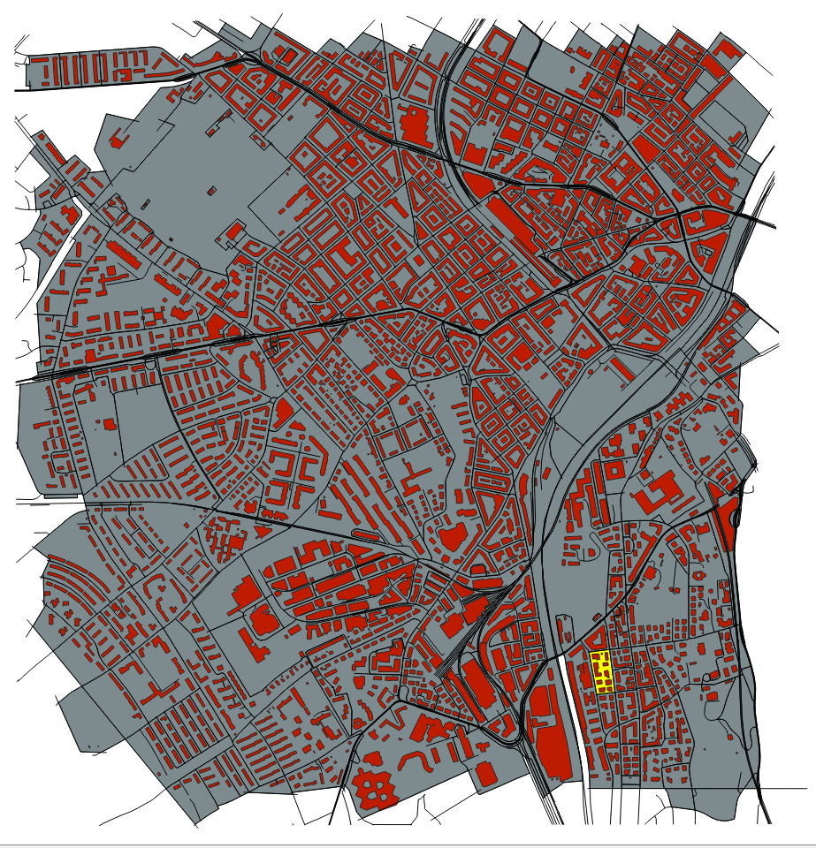
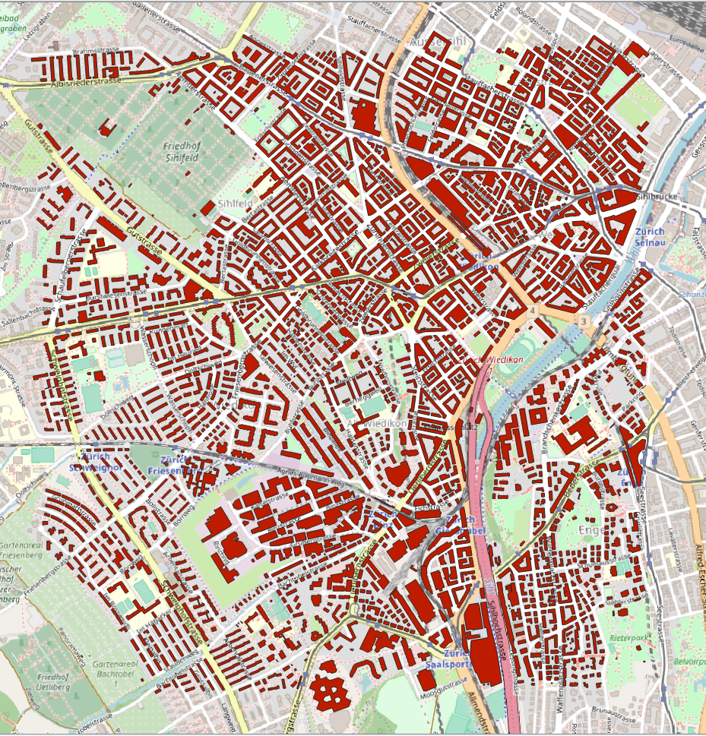
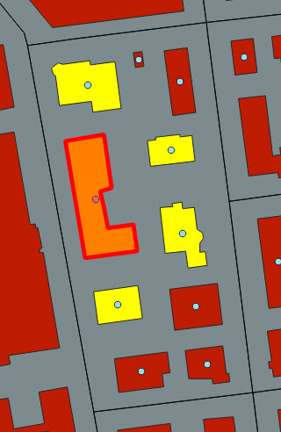
Making Plots in Alt-Wiedikon - OSM
406 Plots
Notes:
Diff bldg. types and age

Slide 14
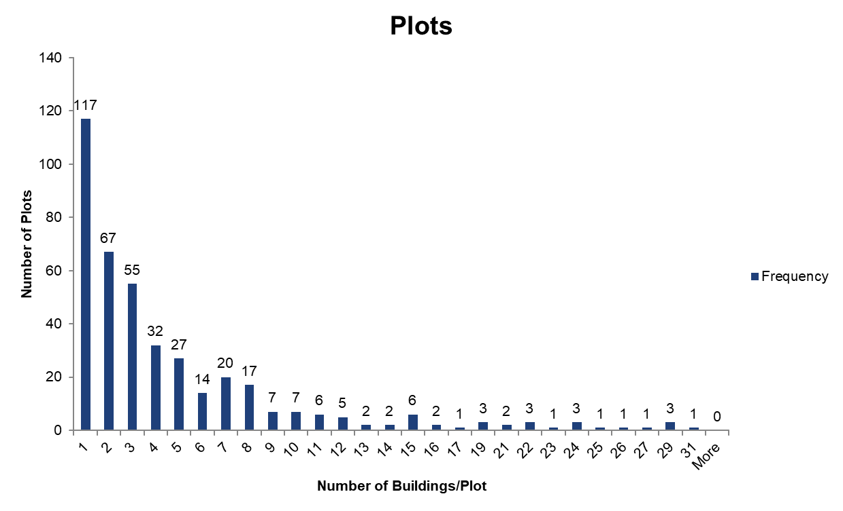

Making Plots in Alt-Wiedikon - OSM
406 Plots
117 Plots – only one building block!
= no Community PV option
Notes:
Those are still building blocks! Many individual buildings

Slide 15
Potential ZEV Members – example of a Plot
A | B | C | D
B | A | A | A
C | … | D | C
D | … | … | …
E | … | … | …
B
Number of Possible ZEVs for A: 15
A +B + C + D + E
A +B + C + D
A +B + C + E
A +B + D + E
A +B + C + E
…
A + B …
C
A
D
E
Notes:
Radius taken for the buildings
In reality these are ZEVs as they are multiple buildings

Slide 16










Agent-based Modelling

Slide 17

Emergent Phenomena
“Solar PV is Eco-friendly, Easy…”
“I cannot afford solar PV”
“Climate Change is a conspiracy!”
“My friends think PV is cool”

Slide 18
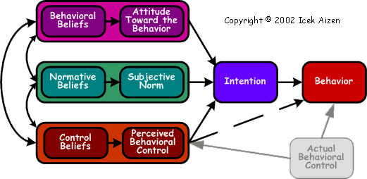
The Theory of Planned Behaviour
“Solar PV is Eco-friendly, Easy…”
“My friends think PV is cool”
“I cannot afford solar PV”
Icek Ajzen, ‘Constructing a TPB Questionnaire: Conceptual and Methodological Considerations’, 2002

Slide 19
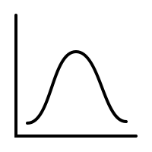

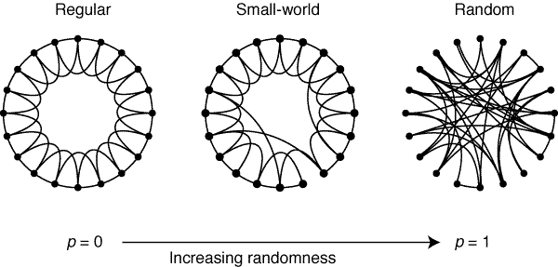
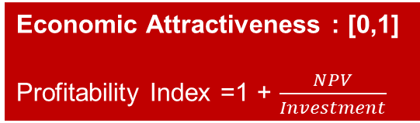
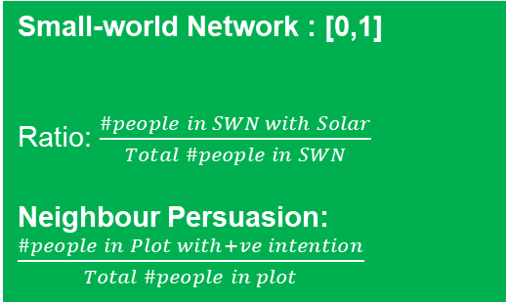
Use of TPB for decision making: Stage I – Idea Generation
Environmental attitude: [0,1]
+
$$Intention= Σ weight∗var>threshold$$
IDEA Generation
Do I want solar?
Yes/No
Variables
Small-world Network : [0,1]
Ratio: $\frac{\#people in SWN with Solar}{Total \#people in SWN}$
Neighbour Persuasion: $\frac{\#people in Plot with+ve intention}{Total \#people in plot}$
Economic Attractiveness : [0,1]
Profitability Index =1 + $\frac{NPV}{Investment}$
Notes:
TPB has 2 stages – intention, and behaviour
Subjective norms – what does society think
PBC - Does agent feel confident enough to do it?
PP = how quickly does the investment pay off compared to other investments
Need to quantify these qualitative ideas
First, let us try to quantify the intention, Forget about the behaviour for now

Slide 20
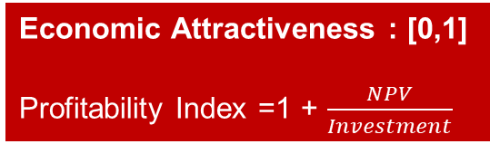
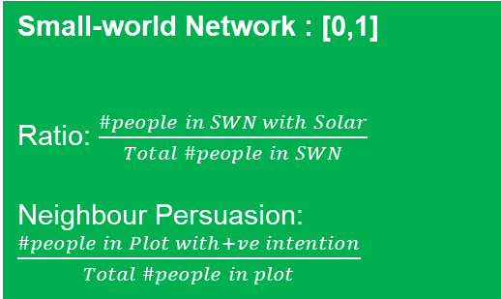
Use of TPB for decision making: Stage II – Behaviour
Environmental attitude : [0,1]
+
Choice:
Individual OR Community based on NPV
Variables
Small-world Network : [0,1]
Ratio: $\frac{\#people in SWN with Solar}{Total \#people in SWN}$
Neighbour Persuasion: $\frac{\#people in Plot with+ve intention}{Total \#people in plot}$
Economic Attractiveness : [0,1]
Profitability Index =1 + $\frac{NPV}{Investment}$
Notes:
TPB has 2 stages – intention, and behaviour
Subjective norms – what does society think
PBC - Does agent feel confident enough to do it?
PP = how quickly does the investment pay off compared to other investments
Need to quantify these qualitative ideas
First, let us try to quantify the intention, Forget about the behaviour for now

Slide 21
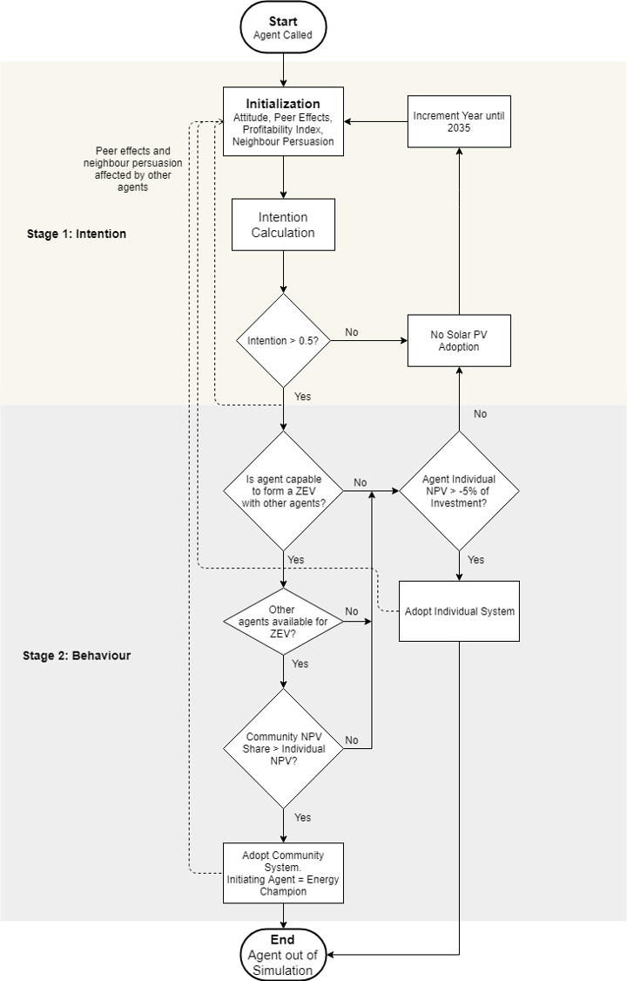
Flowchart Decision-Making

Slide 23
Scenarios
Electricity Prices –
Retail (< 100 MWh annual demand): 24.3 - 14.4 Rp./kWh
Wholesale (> 100 MWh): 6 - 5 Rp./kWh
Unclear if building owners purchase on wholesale markets
Model A – Reduced (~ half the population)
716 building blocks < 100 MWh
Retail Prices
Compensates for CEA Building Aggregation
2 Cases:
No-ZEV → no community solar. Used for calibration
ZEV → communities allowed < 100 MWh. Compare with no-ZEV.
Model B – Alt-Wiedikon
1437 building blocks – entire district
ZEV 2 Cases:
Retail Prices
Wholesale Prices

Slide 24


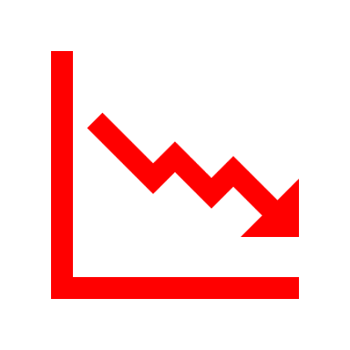

Assumptions
Buildings → Building Blocks
PV Sizes = Max Rooftop Sizes, else
Building Block Sizes quite large = demands large = PV systems large
→ NPVs amazing!
Building Block – Individual, >1 Building Block = Community → different in reality!
Much fewer agents than reality – simpler decision making
Cooperation costs – purely monetary indicators used
Decision making at only owner level: all tenants say YES to a ZEV
Model calibrated with projected historical trend, not validated
Over time:
Constant – Population, Attitudes, peer network, electricity prices, Subsidies and FiTs, ZEV members
Changing – PV Prices, NPVs, Peer Effects
Notes:
Fixing sizes – computationally intensive otherwise

Slide 25


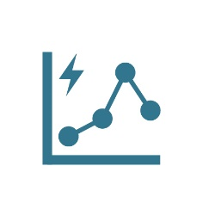
Methodology Overview
Other Inputs
Peer effects, environmental attitudes, agent locations and networks
Prices – PV and Electricity
Regulations – FiTs, Subsidies and ZEV formation
Building Data, Geometry, etc.
CEA Model
Alt-Wiedikon, Zurich
CEA Output Data Processing
ABM for
Building Owners
[Individual/Community Adoption]
Results Visualisation
Adoption levels Individual v Community PV Systems
Parameters
Agent Categories based on building type and ownership
Time: Yearly time steps until 2035

Slide 26
Agenda
Introduction and Motivation
Data and Methodology
Results
Conclusion and Discussion

Slide 27
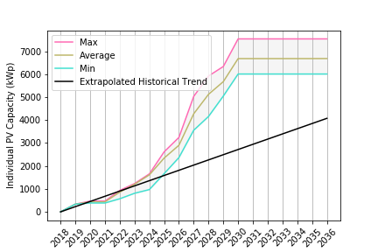
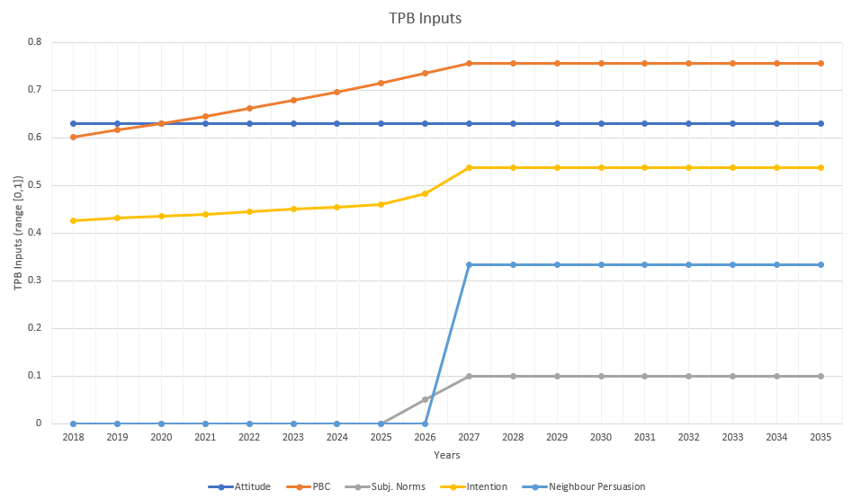
Model A – Reduced no-ZEV
Subsidies Stop
An example Agent’s Variables and Adoption
in 2027
Avg = 6500 kWp
Profitability index
attitude
intention
Neighbour persuasion
PV
Peer Effects
Peer effects
Targets Exceeded 1.5 times!
Peers adopted in 2025, 2026
Plot members have positive intention in 2027
Notes:
1.5 times projected
Calibration

Slide 28
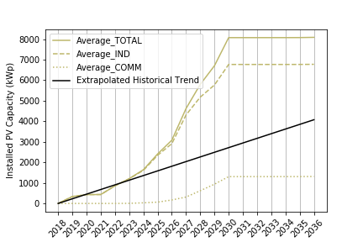
Model A – Reduced ZEV – Community allowed
Avg TOTAL = 8000 kWp
Total Adoption ~ 2x trend
2026-2030: ~ 1000 kW/year
81% Individual
19% Community – only. And delayed.
Individual = 6500 kWp
Community = 1500 kWp
Notes:
2times projected
Community
Levels
EGIDs

Slide 29
Model A – Reduced ZEV – Community allowed
22 ZEVs
50 buildings
113 Individual Adopters
Why did they not adopt community?
40%: No other potential ZEV member crossed intention
30%: The community size was exceeding 100 MWh
30%: I’m alone in my plot

Slide 30
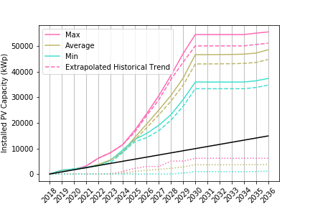
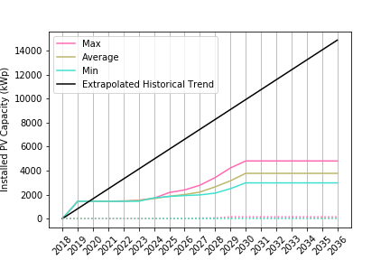
Model B – Alt-Wiedikon
Retail
Expensive Electricity
Wholesale: 4 times cheaper electricity!
Avg TOTAL = 48000 kWp
Avg TOTAL = 4000 kWp
Avg Comm = 4000 kWp
Notes:
Trend of projected
Patterns similar – coherent models
Retail – big PVs, amazing prices → adopt solar!
Community takes time, agents do not cross intention together
Wholesale → only adopt post 2024 – prices fall, peer effects increase. Smaller PV systems install, not larger

Slide 31
Agenda
Introduction and Motivation
Data and Methodology
Results
Conclusion and Discussion

Slide 32
Conclusion: Key Learnings
Targets exceeded. Subsidies stop and so do the adoptions → PV Prices not falling enough to recover. Lower subsidy magnitude but extend.
Community Formation Difficult and depends on many factors simultaneously
Big PVs – economies of scale don’t matter
Decision-making process – too many things must fall into place for community PV
Many buildings – not many options
Individual adoption i.e. Aggregated buildings == ZEVs!
Electricity price levels extremely important to estimate future adoptions
Owners don’t know about wholesale markets?
Lack of expertise?
What will most likely happen – average of Retail + Wholesale adoption levels
Notes:
Model ZEV without solar

Slide 33
Future Work – Discussion and Limitations
Consider individual buildings, not blocks
→ even individual apartments! Better distinction between individual and community
Varying PV Sizes – consider optimal for all
Electrical Grid distribution level data – plot formation
Vary plot sizes
Community formation through greater feedback in decision-making
Agents convince others in the same year
Adoption Process: If community not possible, then possibly agents wait
Social/Individualistic nature of people can be important to consider
Memory for the agents
Surveys to gather data
Notes:
Environmental attitudes
Peer networks
Economic indicators most valued, discount rates and paybacks considered
Electricity Purchase Options

Slide 34
Personal Conclusions
Deciding how to model decision-making is DIFFICULT!
ABM can be very subjective
Mood Shift: I can see myself doing this for 4 years!

Slide 35

Thank You! Time for questions and discussion! ☺
@ Danielle
& Alejandro
@ Profs and Teams - A/S and SusTec
@ Peers – positive peer effect ☺

Slide 36
Back-up Slides

Slide 37
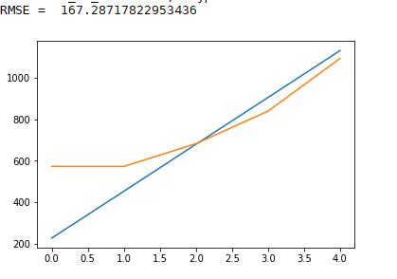
Calibration - Model A
Weights | Value
Economic Attractiveness | 0.3
Peer effects | 0.35
Environmental Awareness | 0.35
Negative NPV allowed | YES -15% of Investment costs
Weights | Value
Economic Attractiveness | 0.31
Peer effects | 0.3
Environmental Awareness | 0.39
Negative NPV allowed | YES -5% of Investment costs
RMSE = 117
Notes:
Negative NPV necessary to emulate adoptions
Maybe people consider long paybacks or low discount rates

Slide 38
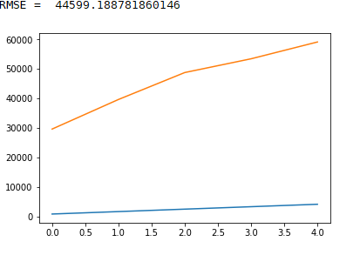
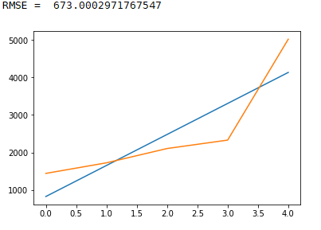
Model B – Alt-Wiedikon
Weights | Value
Economic Attractiveness | 0.31
Peer effects | 0.3
Environmental Awareness | 0.39
Negative NPV allowed | YES -5% of Investment costs
Weights | Value
Economic Attractiveness | 0.33
Peer effects | 0.42
Environmental Awareness | 0.25
Negative NPV allowed | NO

Slide 39
My case: So. Many. Variables!
Environmental attitudes/beliefs Technical aspects
Economics
Past opinions
Individualistic/Social
Cost effectiveness
No. of installations in neighbourhood
Feedback based on peer decisions
What Peers Say
General Social Image of PV
Small-world Network (Closest people – Friends, Family)
Does agent feel confident enough to do it?
Money/Economic Attractiveness
Time
Skills
Support and Persuasion
Notes:
What can be included in attitude toward the behaviour
What forms subjective norms
What forms PBC

